Slide 1

Image Cryptography

Slide 2
What is Cryptography?
Cryptography is the science of using mathematics to encrypt and decrypt data.
Cryptographic Algorithm- mathematical function used in encryption/decryption.
Security of encrypted data depends on-strength of cryptographic algorithm and secrecy of the key.

Slide 3
Advanced Encryption Standard
AES is a symmetric Encryption Algorithm.
This algorithm used 128 bit data block and may use three different key sizes 128,196, and 256 bits.
The 128 bit data block is divided into 16 bytes and are mapped into 4*4 array called State.
It is an iterative algorithm.

Slide 4
AES Algorithm Working
Key Expansions
Initial Round
Rounds
(a) SubBytes a non-linear substitution step where each byte is replaced with another according to a lookup table.
(b) ShiftRows a transposition step where the last three rows of the state are shifted cyclically a certain number of steps.
(c) MixColumns a mixing operation which operates on the columns of the state, combining the four bytes in each column.(d) AddRoundKey
Final Round (no MixColumns)
(a) SubBytes
(b) ShiftRows
(c) AddRoundKey
. Round keys are derived from the cipher key using Rijndael's key schedule. AES requires a separate 128-bit round key block for each round plus one more.
(a) AddRoundKey-each byte of the state is combined with a block of the round key using bitwise xor.

Slide 5
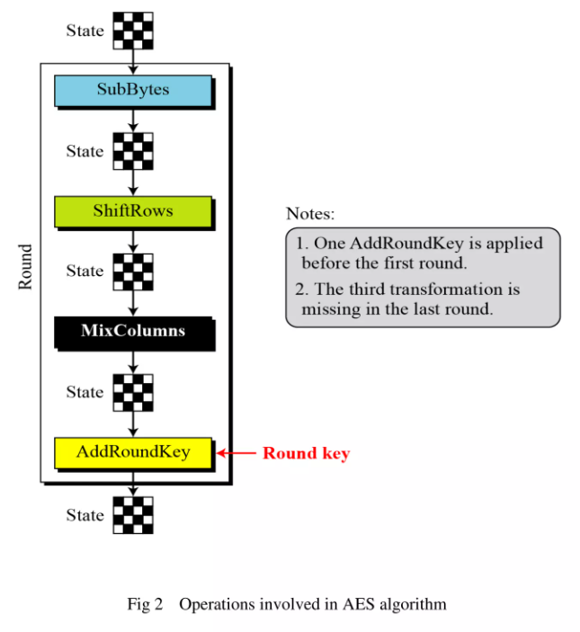


Slide 6
Graphical User Interface (GUI)
Gives program distinctive “look” and “feel”.
Provides users with basic level of familiarity.
Built from GUI components (controls, widgets, etc.) - User interact with GUI component via mouse , keyboard, etc.
Java GUI (“Swing”) has components.
Windows GUI has controls.
Unix GUI has widgets.
Examples: labels, buttons, check boxes, radio buttons, text input boxes, pull down lists
Java Swing compnents: JLabel, JButton, JCheckBox, JRadioButton, JTextField, JTextArea, JComboBox

Slide 7
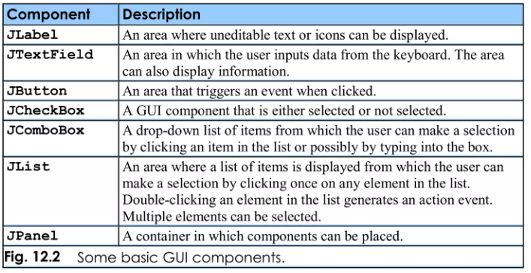
Some Basic GUI Components

Slide 8
Abstract Window Toolkit (AWT)
The Abstract Window Toolkit is a platform-dependent API used to develop GUI (Graphical User Interface) or window-based applications in Java. Basically, the AWT is a member of the Java Foundation Classes – the approved API implementing a GUI for a Java program.
Attributes of AWT
It is a collection of essential user interface elements.
It comprises several editing tools like imaging, graphics, and more.
It utilizes window-system controls.
It provides functionality to incorporate colors, shapes, and font classes.
It is robust.

Slide 9
Image Encrytion And Decryption
Encryption is a process which uses a finite set of instructions called an algorithm to convert original image, known as plain image, into cipher image,its encrypted form.
Cryptographic algorithm normally requires a set of characters called a key to encrypt or decrypt data or image.
With the help of key and the algorithm we can encrypt or decrypt the plain image into the cipher image and then cipher image back to the plain image.

